Slide 1
UBL
COMPARISON OF ADJECTIVES
Dr. Hariyadi Raharjo
http://www.free-powerpoint-templates-design.com

Slide 2
Your Lecturer
Dr. Didik Hariyadi Raharjo, M.Pd.
081288111430

Slide 3
Lecture Agenda
01
Opening
In this phase, the lecturer will deliver the learning objectives and check the students' attendance.
02
Lecture and Discussion
In this phase, the lecturer will explain the learning material, give some examples and invite you to discuss the materials.
03
Evaluation
In this phase, the lecturer will check your understanding by giving some instructions and questions.
04
Closing
In this phase, the lecturer will invite you to make conclusions and provide additional explanations.

Slide 4

Are You Ready?
Just prepare yourself.

Slide 5

Comparison of Adjectives
One way to describe nouns (people, objects, animals, etc.) is by comparing them to something else. When comparing two things, you’re likely to use adjectives like smaller, bigger, taller, more interesting, and less expensive. Notice the ‑er ending, and the words more and less. A mistake that both native speakers and non-native speakers make is using incorrectly formed comparative adjectives.

Slide 6
Are you Ready?
Let’s learn about Comparison of Adjectives

Slide 7

Comparative Adjectives
Form
Comparative Adjectives
Comparative adjectives are used to compare differences between the two objects they modify (larger, smaller, faster, higher). They are used in sentences where two nouns are compared, in this pattern:
Form: Noun (subject) + verb + comparative adjective + than + noun (object).
Examples:
My house is larger than hers.
This box is smaller than the one I lost.
Your dog runs faster than Jim's dog.
The rock flew higher than the roof.
Jim and Jack are both my friends, but I like Jack better. ("than Jim" is understood)

Slide 8
Superlative Adjectives
Form
Superlative Adjectives
Superlative adjectives are used to describe an object which is at the upper or lower limit of a quality (the tallest, the smallest, the fastest, the highest). They are used in sentences where a subject is compared to a group of objects.
Form: Noun (subject) + verb + the + superlative adjective + noun (object).
Examples:
My house is the largest one in our neighborhood.
This is the smallest box I've ever seen.
Your dog ran the fastest of any dog in the race.
We all threw our rocks at the same time. My rock flew the highest. ("of all the rocks" is understood)

Slide 9
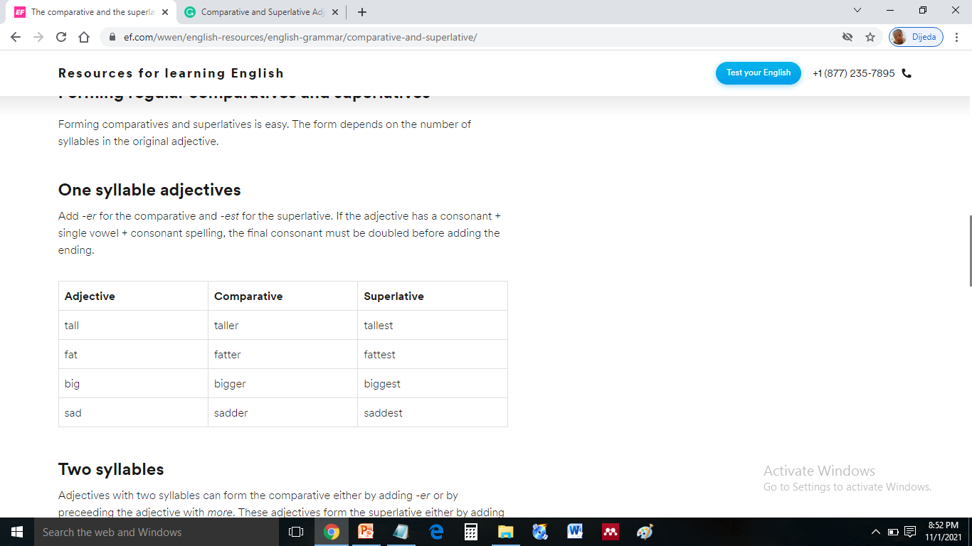
Forming regular comparatives and superlatives
Form
One syllable adjectives
Add -er for the comparative and -est for the superlative. If the adjective has a consonant + single vowel + consonant spelling, the final consonant must be doubled before adding the ending.
Examples:

Slide 10
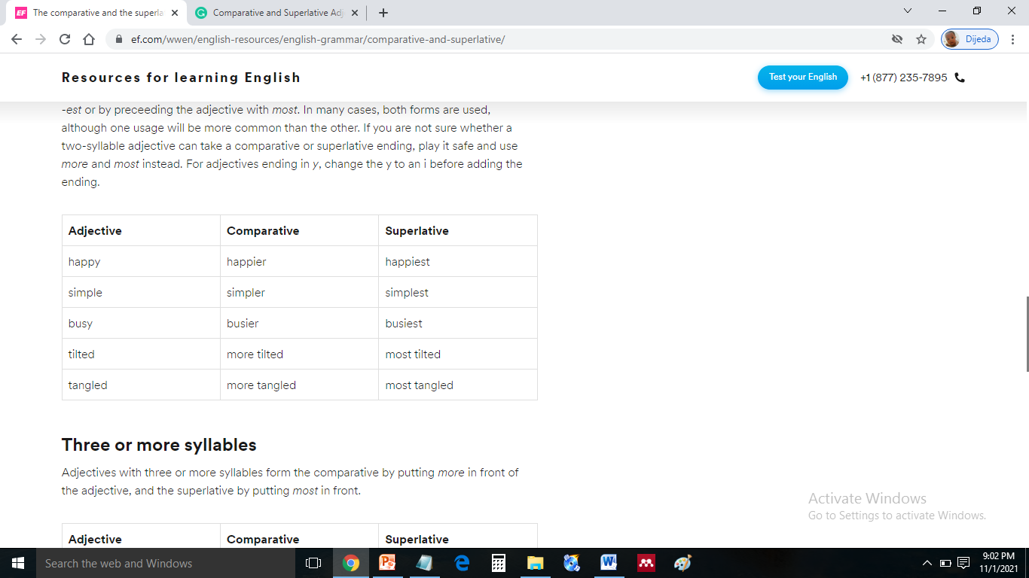
Forming regular comparatives and superlatives
Form
Two syllables
Adjectives with two syllables can form the comparative either by adding -er or by preceeding the adjective
with more. These adjectives form the superlative either by adding -est or by preceeding the adjective with
most. In many cases, both forms are used, although one usage will be more common than the other.
If you are not sure whether a two-syllable adjective can take a comparative or superlative ending, play it safe and use more and most instead. For adjectives ending in y, change the y to an i before adding the ending.
Examples:

Slide 11
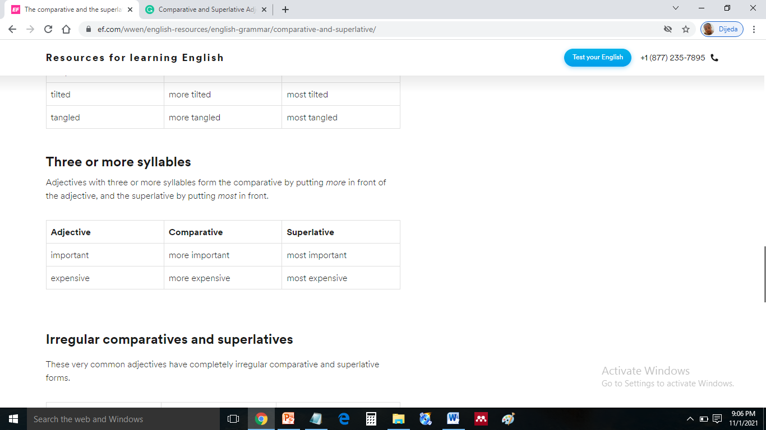
Forming regular comparatives and superlatives
Form
Three or more syllables
Adjectives with three or more syllables form the comparative by putting more in front of the adjective, and
the superlative by putting most in front.
Examples:

Slide 12
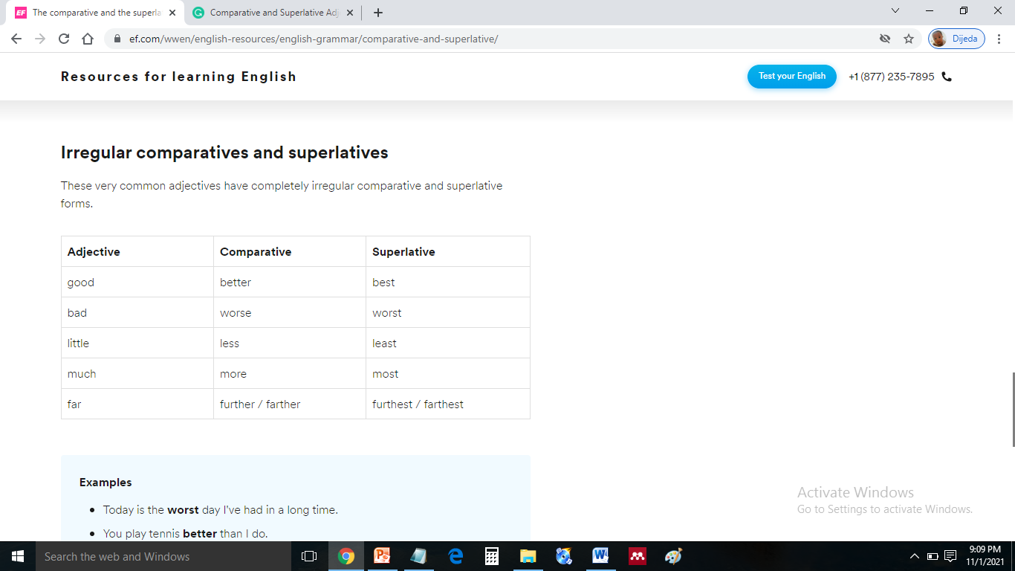
Forming regular comparatives and superlatives
Form
Irregular comparatives and superlatives
These very common adjectives have completely irregular comparative and superlative forms.
Examples:
Today is the worst day I've had in a long time.
You play tennis better than I do.
This is the least expensive sweater in the store.
This sweater is less expensive than that one.
I ran pretty far yesterday, but I ran even farther today.

Slide 13
Do You Understand?
Let’s discusse together!.

Slide 14
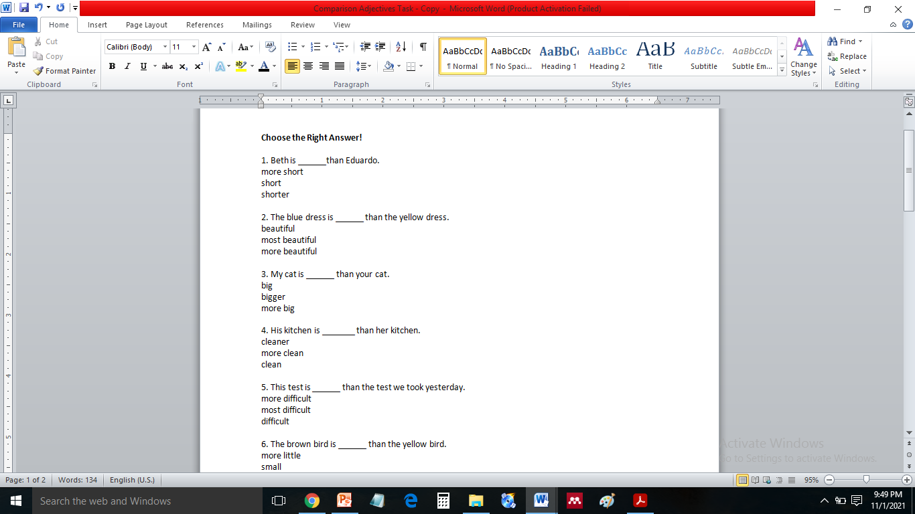
EVALUATION
Comparison of Adjectives
Directions: Choose the Right Answer!

Slide 15
Thank you
Good Luck

